Slide 1
Introduction to OpenDSS
Winter, 2016

Slide 2
What is OpenDSS?
Available through EPRI
A script driven, frequency-domain electrical circuit simulation tool.
Harmonics solvers rather than power flow.
Used for Dynamic Distribution system modeling.
Supports all rms steady-state analyses commonly performed in distribution planning.

Slide 3
Used for Distributed Generation
Interconnection studies/screening
Solar PV voltage rise/fluctuation
Wind power variations impact
Hi-penetration solar PV impacts
Harmonic distortion simulation
Dynamics/islanding

Slide 4
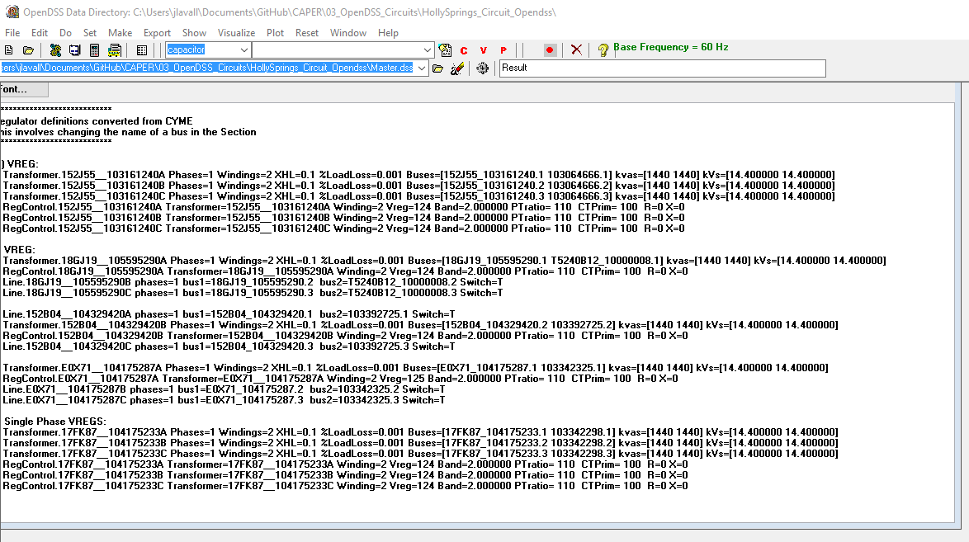
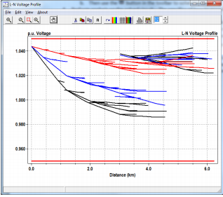
Setup Steps (1/4)
Download the installer:
http://sourceforge.net/projects/electricdss/files/
Download OpenDSSInstaller764_79.exe

Slide 5
Setup Steps (2/4)
Connect to EPRI Repository:
Install a 32-bit TortoiseSVN client from tortoisesvn.net/downloads.
Recommendation:
From the TortoiseSVN General Settings dialog and click the last check box, to use "_svn" instead of ".svn" for local working directory name. Then, to grab the files from SourceForge: 1 - create a clean directory such as "c:\opendss" 2 - right-click on it and choose "SVN Checkout..." from the menu 3 - the repository URL is
http://electricdss.svn.sourceforge.net/svnroot/electricdss

Slide 6
Setup Steps (3/4)
Install Sandia National Lab/Georgia Tech’s GridPV:
https://pvpmc.sandia.gov/applications/gridpv-toolbox/
Fill in information at the bottom of the page & Download GridPV & User Manual
Once zip file completely downloaded, follow these steps:
Extract the zip file to the desired location
Open MATLAB
Go to the FILE menu -> SET PATH. (For MATLAB 2013, “Set Path” button under the HOME toolbar ribbon.
Push “Add with Subfolders” and select GridPV folder and press OK (this will add the GridPV Toolbox to your path file)
Click “Save”
**Important** Make sure you remove previous versions of the GridPV Toolbox from your path.
7. Go to MATLAB‟s help and you should see GridPV Toolbox listed with your other toolboxes. (For MATLAB 2013, in the MATLAB help click “Supplemental Software” at the bottom left.)

Slide 7
General Overview of OpenDSS
DSS Executive
Commands
Options
Circuit
Solution
V
[Y]
I
PDElement
PCElement
Controls
Meters
General
Line Transformer Capacitor Reactor
Load Generator Vsource Isource Storage
RegControl CapControl Relay Reclose Fuse
Monitor EnergyMeter Sensor
LineCode LineGeometry WireData LoadShape GrowthShape Spectrum TCCcurve XfmrCode

Slide 8
Reference Docs
OpenDSS Primer
OpenDSS Cheatsheet
OpenDSS Manual
Sandia Report, GridPV, August 2013
Anything located in ‘/04_OpenDSS Docs’

